Slide 1


Kadi Sarva Vishwavidyalaya
Bholabhai Patel College of Computer Studies - BCA
BCA SEMESTER – VI
BCA – 605
“PROJECT PHASE - II”
“CLOTHIFY YOURSELF”
STUDENT NAME | EXAM NUMBER | ENROLLMENT NUMBER
PRAJAPATI DHRUV | 016075 | 18BCA04080
ADIDRAVIDA VIGNESH | 016251 | 18BCA04296
CHIRAG PANCHAL | 016052 | 18BCA04053
PRAJAPATI YASH | 016263 | 18BCA04312

Slide 2
Clothify yourself
The online shopping hub

Slide 3
Title:- Clothify yourself Definition:-
Clothify yourself is web based system which allow consumer to directly buy clothes from online.

Slide 4
Project scope:-
It is a web base application.
Reduce the manual work.
It is fully handled by the administration.
Clothify yourself provide user friendly interface.

Slide 5
Project Objective:-
To Provide online shopping to customer.
To Provide More facilities than local shop.
Proposed system manage the information of
shopping.
To Reduce time and money.
Clothify yourself manage the details of shopping,
payments, bills, product, and customer details.

Slide 6
Technology used:-
Front end:- PHP , HTML , CSS
Back end:- MY SQL

Slide 7
Existing system:-
It is traditional way to buy a clothes.
In existing system customer come and buy clothes from the shop.

Slide 8
Advantages of Existing System:-
Customer can check the quality and also check
clothes size.
Customer can inspect the clothes closely before
buy it.
Customer don’t have to wait day or week to get
the clothes/product.
Customer can buy clothes immediately from
shop.
Customer get satisfying clothes/products from
shop.

Slide 9
Disadvantage of Existing System:-
Customer waste too much time to choose the
product.
It may be possible customers can’t purchase
clothes because varieties are limited in the shop.
It can be expensive.
Shopping in a crowded place it is more harmful
in this pandemic situation.

Slide 10
Operational level problems of existing system:-
Customer opens a lots of clothes but they leaves
without buying them.
They can’t handle huge number of customer at a
time.

Slide 11
Technical level problems of existing system:-
They don’t have computerized system that’s why
they can’t store more data and information.
If existing system buy the computerized system,
it can be expensive for small shop’s.
In existing system there is no back up for data if
system will be crashed then whole data will be lost.

Slide 12
Informational level problems of existing system:-
Due to lack of advertisement management their
information for the new product can’t reach to the
customers.
The cost of advertisement is very expensive.

Slide 13
Proposed system:-
Easy way to shop in this pandemic situation.
In a proposed system customer can purchase the
clothes/products from online platform.

Slide 14
Advantages of proposed system:-
Customer can buy the clothes from anywhere.
Customers can purchase according their choice.
Filters are included so that customer can easily
search their choice.
Customer can check availability of clothes.
There are many options of payment like cash on
delivery, pay through apps and also net banking.
Provide some discounts.

Slide 15
Disadvantages of proposed system:-
Customer can’t check the clothes/products before
buying it.
Sometimes customer can facing server problem.
lack of user’s knowledge.
Delivery delay.
It may be problem in clothes size and material.

Slide 16
SRS including functional and non-functional requirement:-
Software Tools:-(For developing)
Database Server:- my SQL
Client:- internet explorer, mozilla fire fox, chrome ,etc.
Development tools:- VS code editor
Programming language:- PHP

Slide 17
Deployment:-
1. Internet :- A full internet connection require.
2. Operating System:- works on all operating
system.
3. Hardware requirement:-(Minimum)
In PC:-
- Processor:- Pentium IV 2.66GH
- RAM :- 500MB or up to 500MB
- Hard disk :- 40GB
- NIC :- For each party
In mobile:-
- RAM:- 500MB or up to 500MB

Slide 18
Hardware Specifications :-
Processor :- Intel core i3 or up
Ram :- 2GB
Hard disk :- 200 GB

Slide 19
Functional requirement in SRS:-
Customer can login with valid user id and password.
New user can enter with creating new id.
Customer can view/edit personal details & other details.
Customer can view all available product & compare them.
Customer can add their favourite clothes in add to
bag.
Customer can buy clothes.
Customer can give the feed back of services &
product.
Costumer can log out after buying clothes.
Visitors can visit the site without registration.

Slide 20
Non-Function requirement:-
Provide 24*7 service.
Give fast response to customer.
The system shall contains a huge number of items & user without any fault.
Security :-Must be accessible for administrator only.
Database should be maintain & update quickly.
Portability :- Portable for any devices.
In proposed system admin required web hosting
and web space.
Admin need updated version of data base.

Slide 21
Feasibility Study:-
In preliminary investigation feasibility study has three aspects.
1.Technical Feasibility
2.Operational Feasibility
3.Economical Feasibility

Slide 22
Technical Feasibility:-
proposed system needs low configuration system.
Proposed system does not need technical expertise.
Proposed system can handled multiple users at a time.

Slide 23
Operational Feasibility:-
1.The proposed system will improve the total
performance.
2. The proposed system will be available to the
customers throughout the globe.
3. The proposed system will provide a better
market for different dealers.

Slide 24
Economical feasibility:-
The cost of hardware and software is affordable.
High increase in the amount of profit earned by going global.
Easy and cheap maintenance of the system possible.
Very cheap price for going global.

Slide 25
Schedule Feasibility:-
Schedule Feasibility Table:-
No. | Process name | Time duration(Week)
1 | Project Title/Definition | 1
2 | Project Scope/Objective | 1
3 | Existing System, Advantage and Disadvantage | 2
4 | Proposed System, Advantage and Disadvantage | 2
5 | SRS Requirements, Feasibility Study | 1
6 | Modules of Proposed System | 1
7 | DFD,ER diagram, Data base | 4

Slide 26
Schedule Feasibility Pie chart:-

Slide 27
Proposed System Module:-
User interface
1. Log in
2. Registration
3. Personal data editing
4. Search bar
5. Add to favourite
6. Cart
7. Payment
8. Support

Slide 28
Interface for Administrator:-
1. The administrator will have a different login id.
2. Access and manage the whole database.

Slide 29
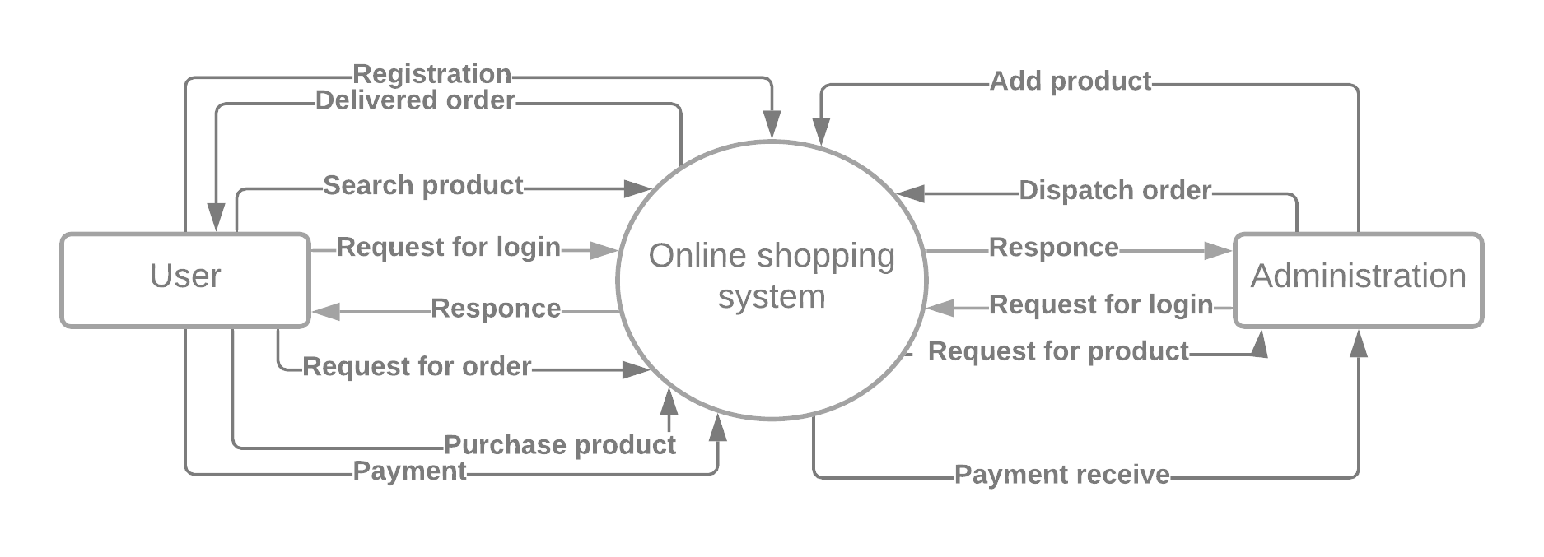
Context level DFD:-
CLOTHIFY YOURSELF
CUSTOMER
USER

Slide 30
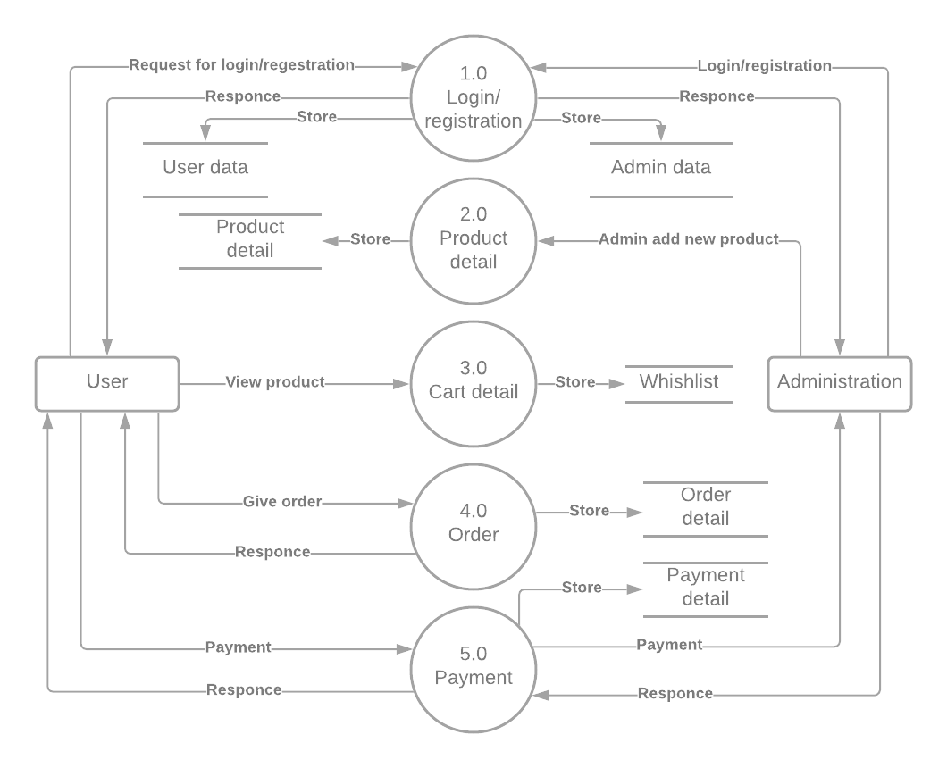
First level DFD:-
TBLCUSTOMER
TBLUSERACCOUNT
TBLPRODUCT
3.0
WISHLIST
CUSTOMER
TBLWISHLIST
USER
TBLORDER
TBLSUMMARY

Slide 31
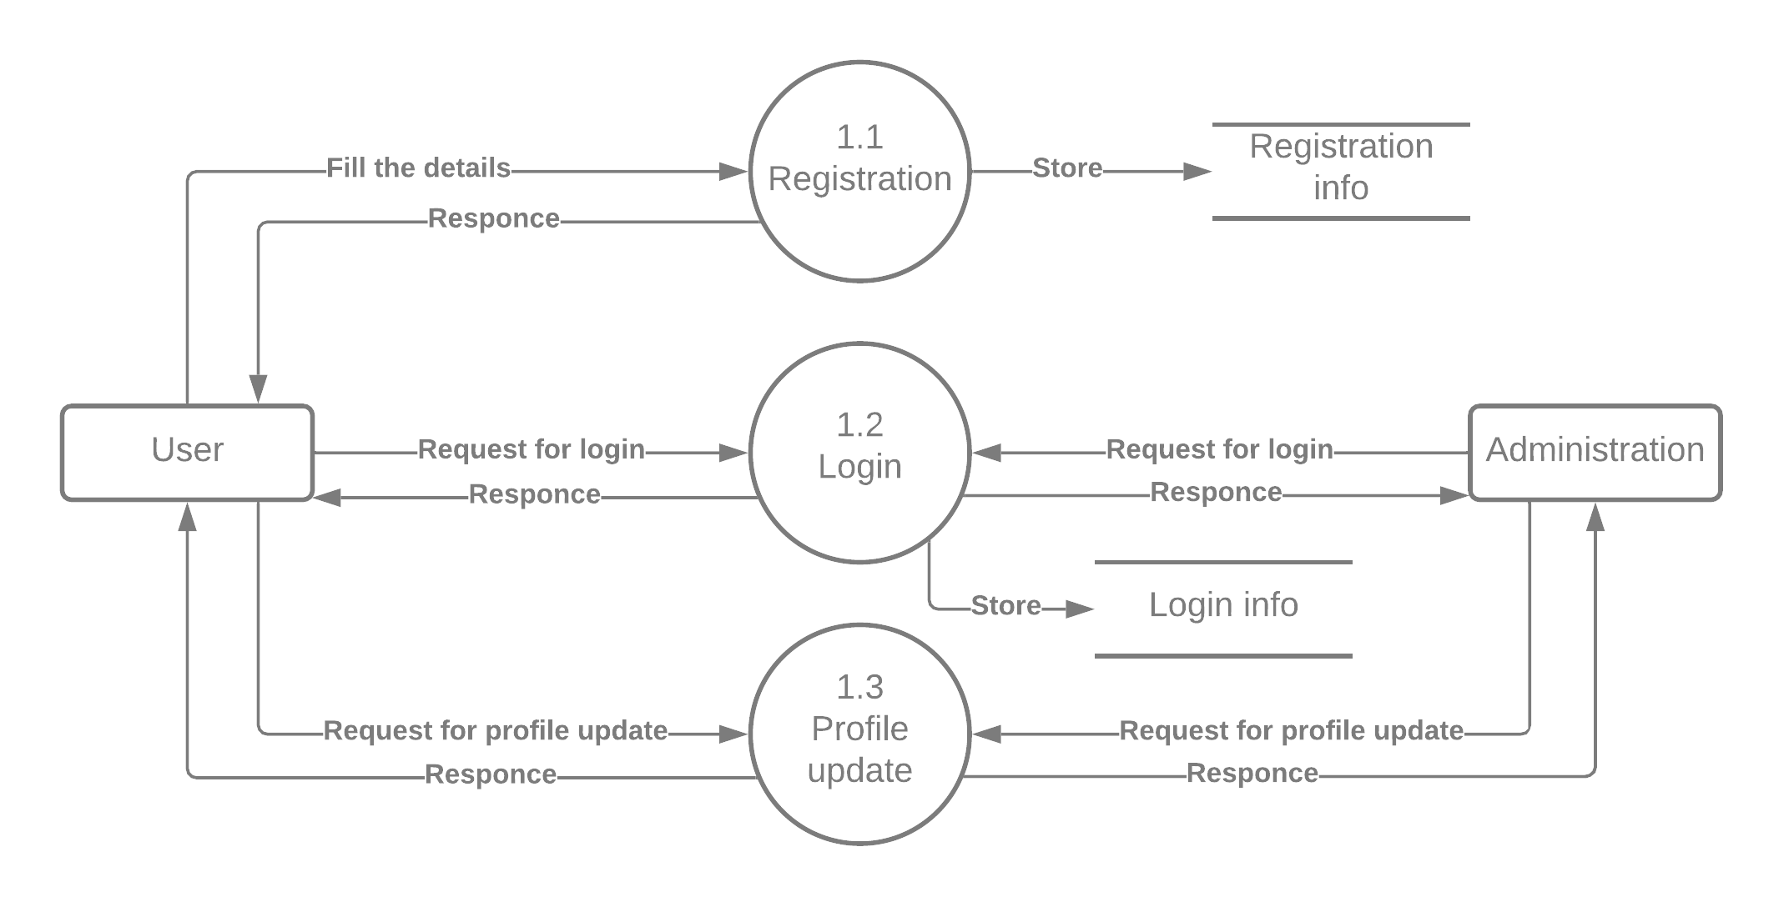
Second level DFD:-
TBLCUSTOMER
CUSTOMER
USER
TBLUSERACCOUNT

Slide 32
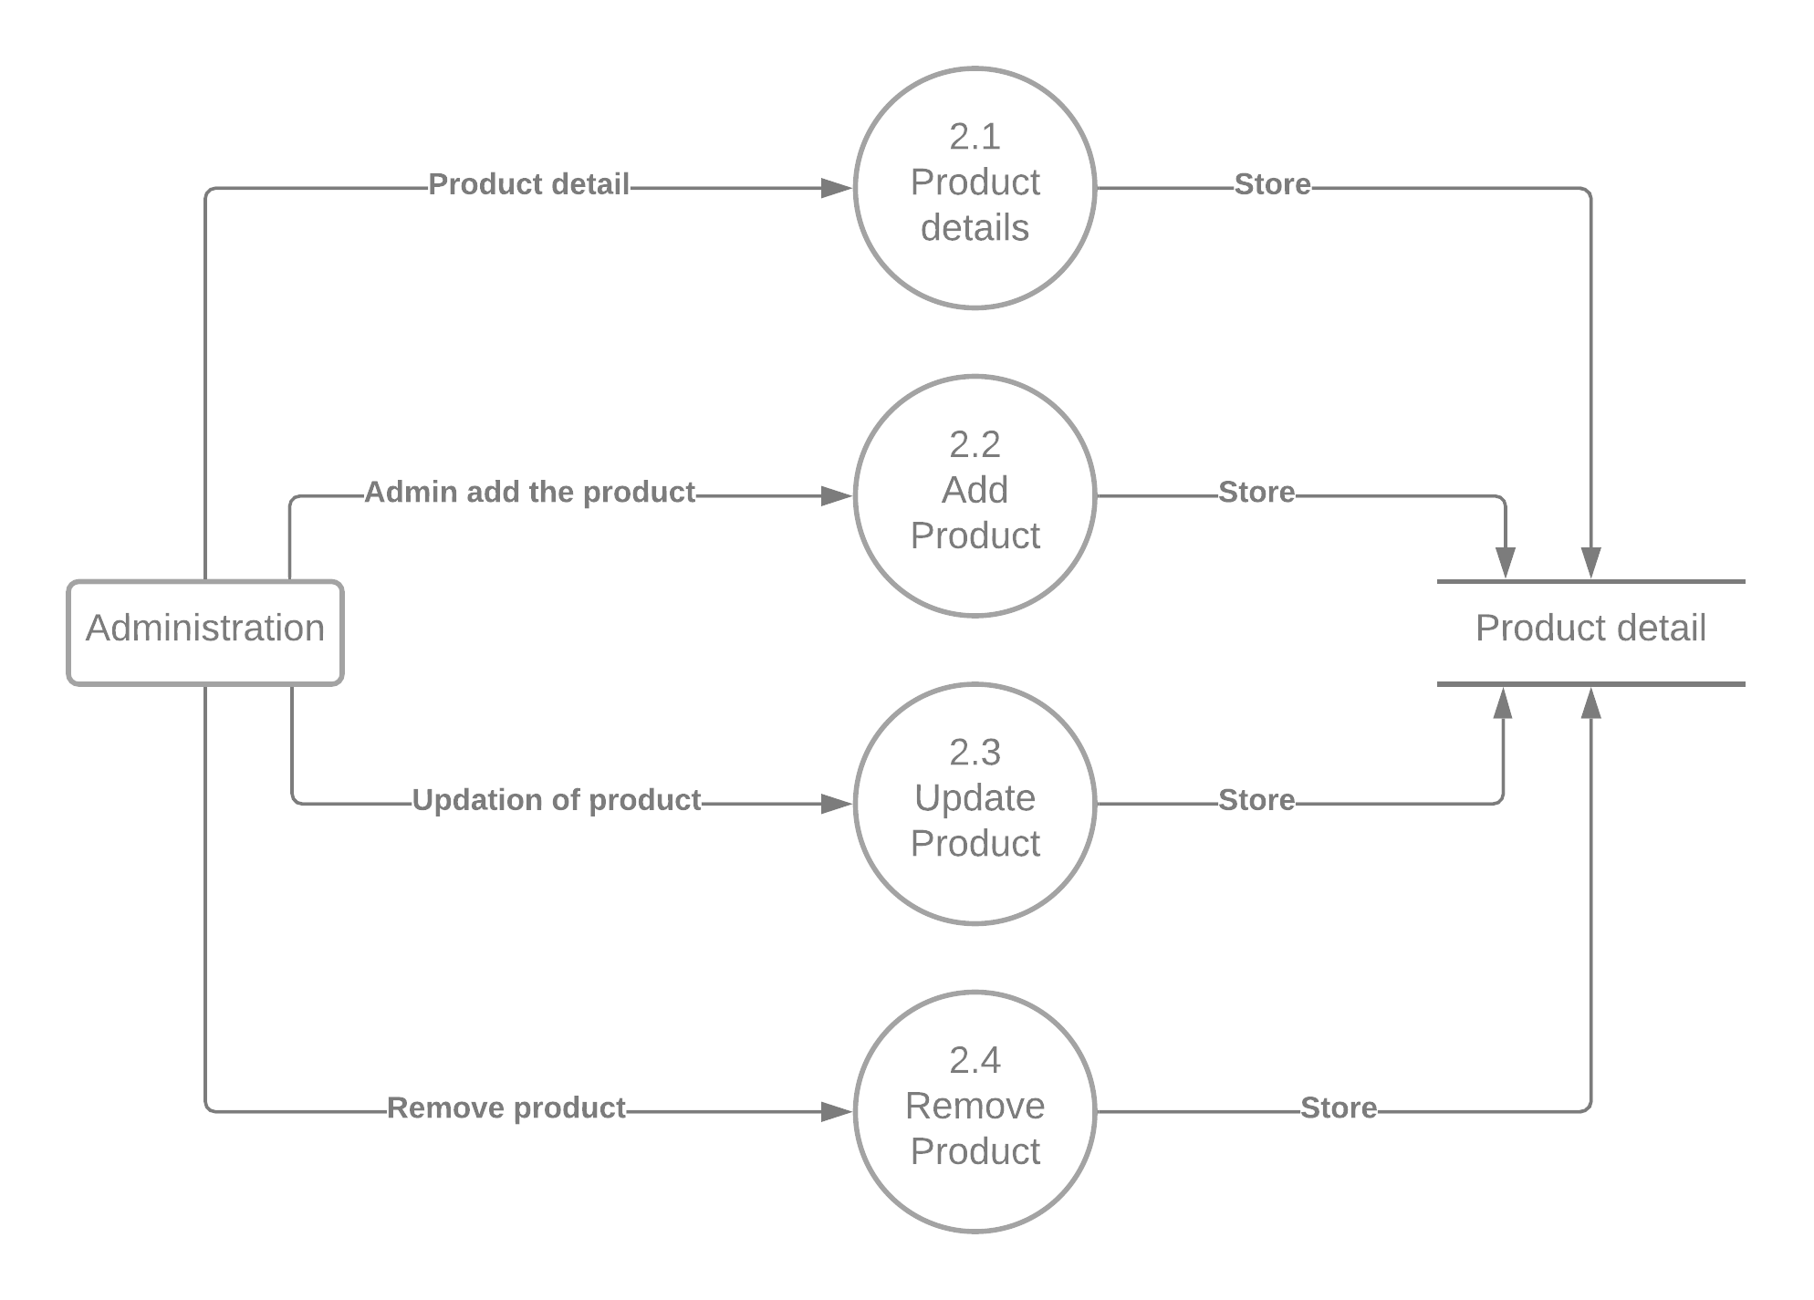
Second level DFD:-
USER
TBLPRODUCT

Slide 33
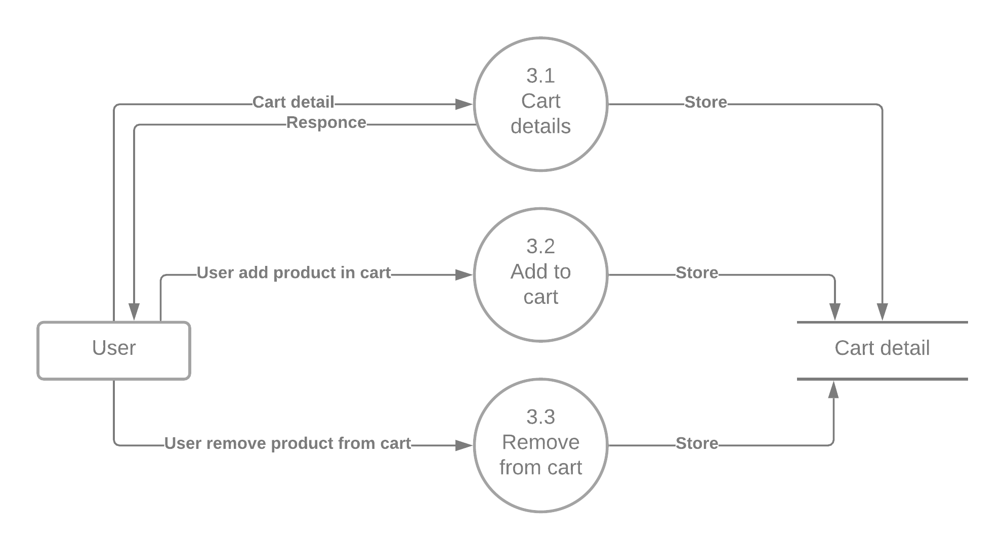
Second level DFD:-
3.1
WISHLIST
3.2
Add to
WISHLIST
CUSTOMER
TBLWISHLIST
3.3
Remove from
WISHLIST

Slide 34
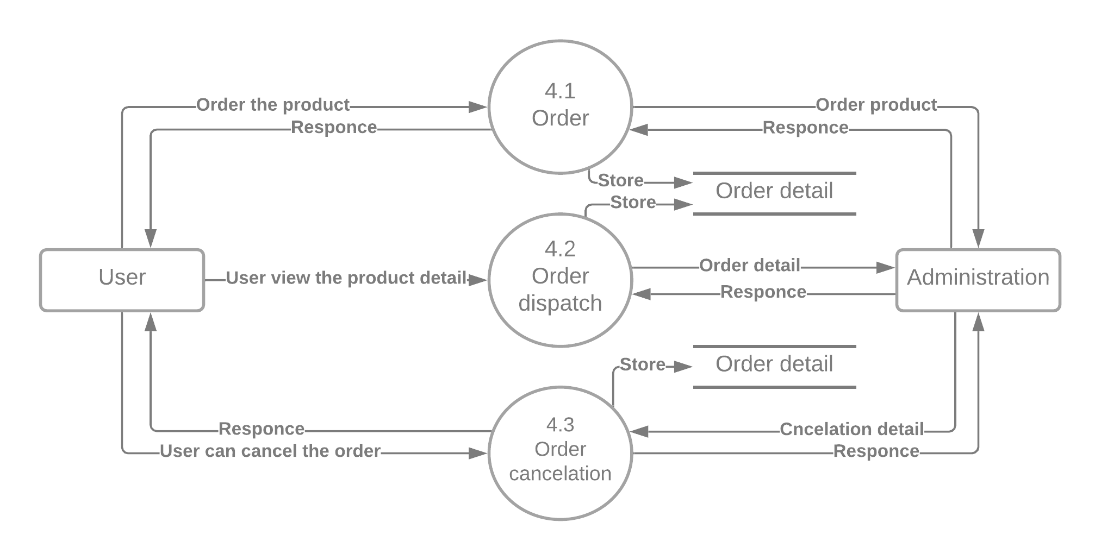
Second level DFD:-
TBLORDER
CUSTOMER
user
TBLORDER

Slide 35
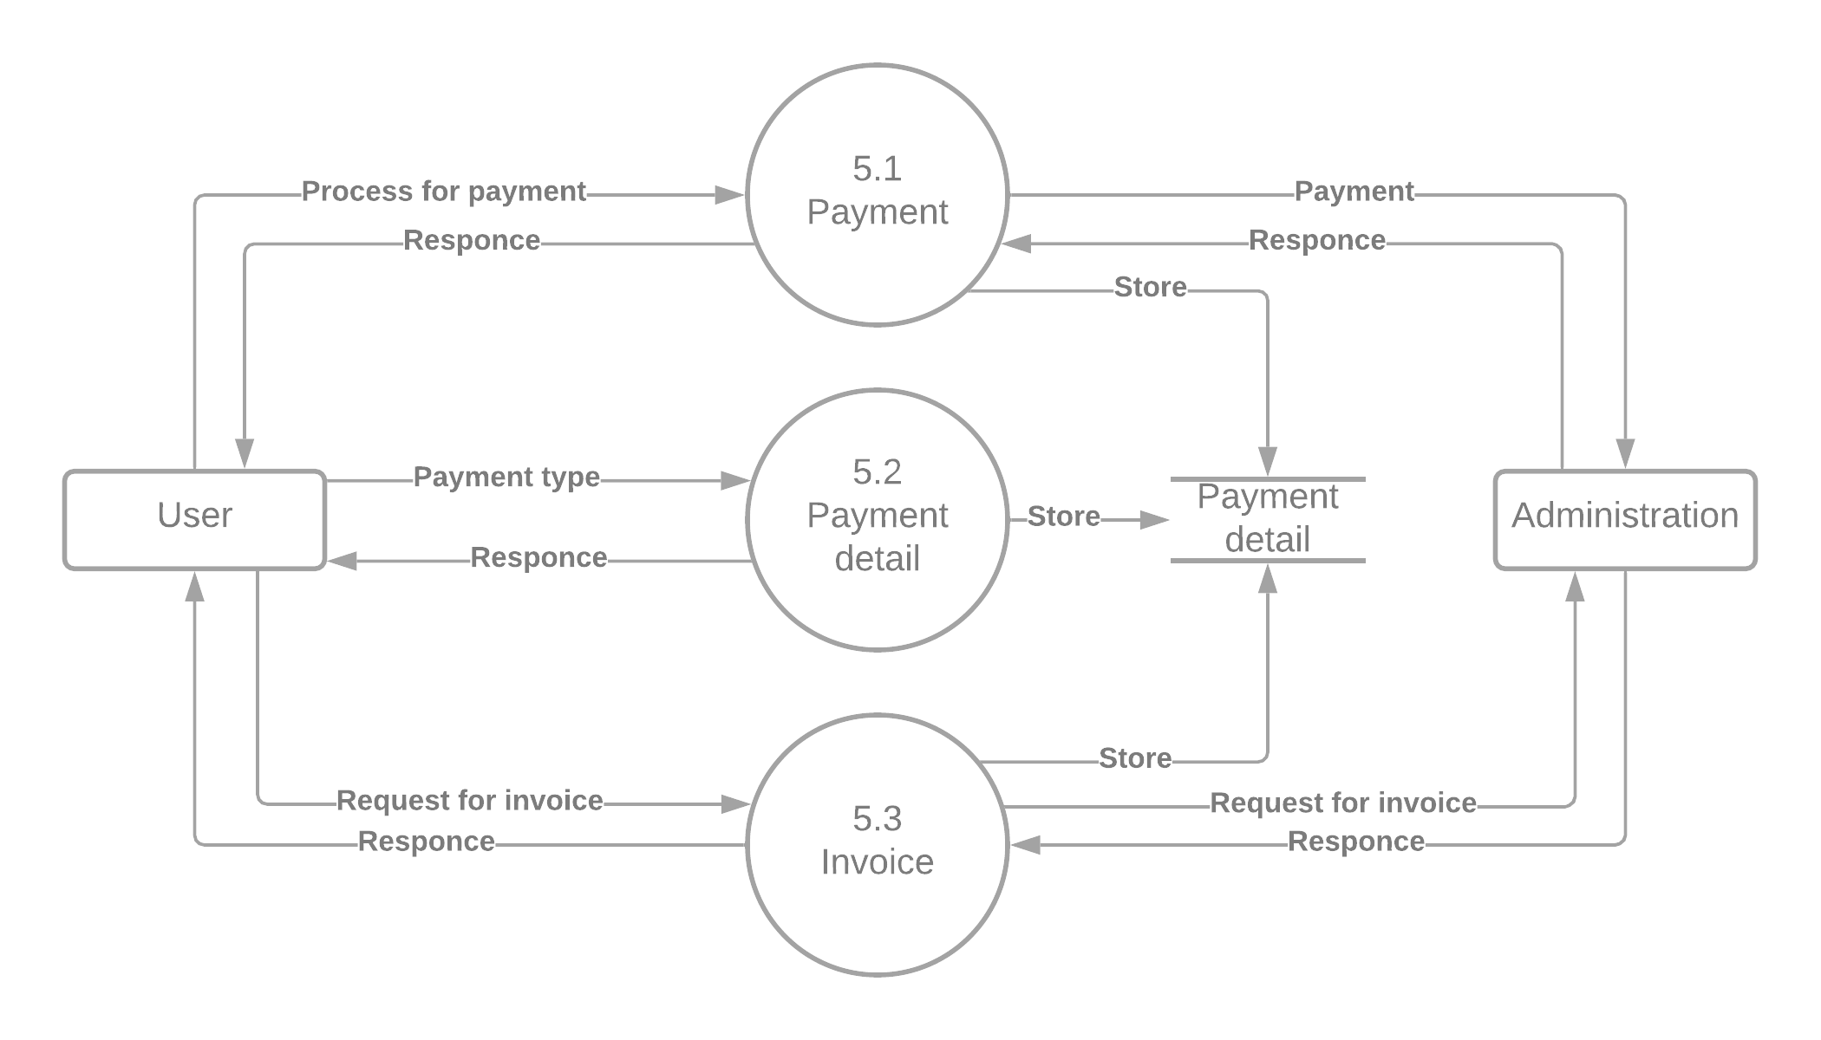
Second level DFD:-
CUSTOMER
tblsummary
user

Slide 36
ER diagram:-
Website name
customerid
cusuname
Online shopping
cuspass
1
userid
fname
1
U_name
tblcustomer
1
Belong to
Manage
lname
1
tbbluseraccount
1
U_pass
cityadd
1
1
Manage
get
Buys
Proid
payment
cateid
M
Proprice
categories
M
tblproduct
customerid
1
M
tblsummary
Prodesc
tblcategory
M
Buys
M
summaryid
Added to
Proqty
1
Does
Made of
M
tblorder
M
M
tblwishlist
M
orderedqty
wishdate
id
Orderid
proid
proid
cusid

Slide 37
Data dictionary:-
1.tblcustomer
Field name | Field type | Size | Constraint | Description
customerid | Int | 11 | Primary key | Auto increment
fname | Varchar | 30 | Not null | First name of user
lname | Varchar | 30 | Not null | Last name of user
cusuname | varchar | 20 | Not Null | Username of user
cuspass | Varchar | 90 | Not null | Password of user
gender | Varchar | 10 | Not null | Gender of user
phone | Numeric | 20 | Not null | Contact no. of user
cityadd | Varchar | 30 | Not null | Address of user

Slide 38
2.tbluser account(admin)
Field name | Field type | Size | Constraint | Description
useid | Int | 10 | Primary key | Auto increment
U_name | Varchar | 122 | Not null | name of user
U_username | Varchar | 122 | Not null | username of user
U_pass | Varchar | 122 | Not null | Password of user
U_role | Varchar | 30 | Not null | Role of user
userimage | varchar | 255 | Not null | Image of user

Slide 39
3.tblproduct
Field name | Field type | Size | Constraint | Description
Proid | Int | 11 | Primary key | Auto increment
Prodesc | Varchar | 255 | Not null | Product description
Cateid | Int | 11 | Foreign key | Category id of product
originalprice | double | - | Not null | Original price of product
Proprice | double | - | Not null | Product price
proqty | int | 11 | Not null | Product description
images | Varchar | 255 | Not null | Product image
prostats | varchar | 30 | Not null | Availibility of product
ownername | varchar | 90 | Not null | Owner name of product
Ownerphone | varchar | 90 | Not null | Phone number of owner

Slide 40
4.tblorder:-
Field name | Field type | Size | Constraint | Description
Orderid | Int | 10 | Primary key | Auto increment
Userid | Int | 10 | Foreign key | User id
Proid | Int | 10 | Foreign key | Product id
orderedqty | int | 11 | Not null | Quantity of ordered product
Orderedprice | doublr | 20 | Not null | Price of ordered product

Slide 41
5.tblsummary:-
Field name | Field type | Size | Constraint | Description
summaryid | Int | 11 | Primary key | Auto increment
Userid | Int | 10 | Foreign key | User id
customerid | int | 11 | Foreign key | Customer id
Payment | Varchar | 15 | Not null | payment
Paymentmethod | Numeric | 15 | Not null | Payment method
orderednum | int | 11 | Foreign key | Ordered number
orderedstats | varchar | 30 | Not null | Availibility of product
claimdate | datetime | - | Not null | Date of order
delfee | double | - | Not null | Delivery fee of order

Slide 42
6.tblcategory:-
Field name | Field type | Size | Constraint | Description
Cateid | Int | 11 | Primary key | Category id of product
categories | Varchar | 10 | Not null | Category name of product
userid | int | 11 | Not null | User id
7.tblwishlist
Field name | Field type | Size | Constraint | Description
id | Int | 11 | Primary key | id of product
cusid | int | 11 | Foreign key | Customer id
proid | int | 11 | Foreign key | product id
wishdate | date | - | Not null | Date of wish product

Slide 43
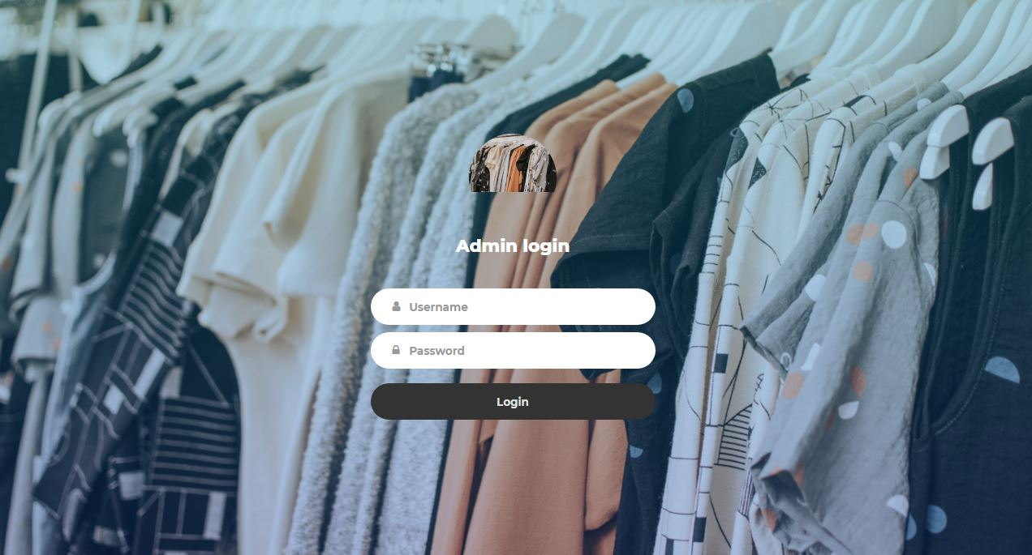
Admin login

Slide 44
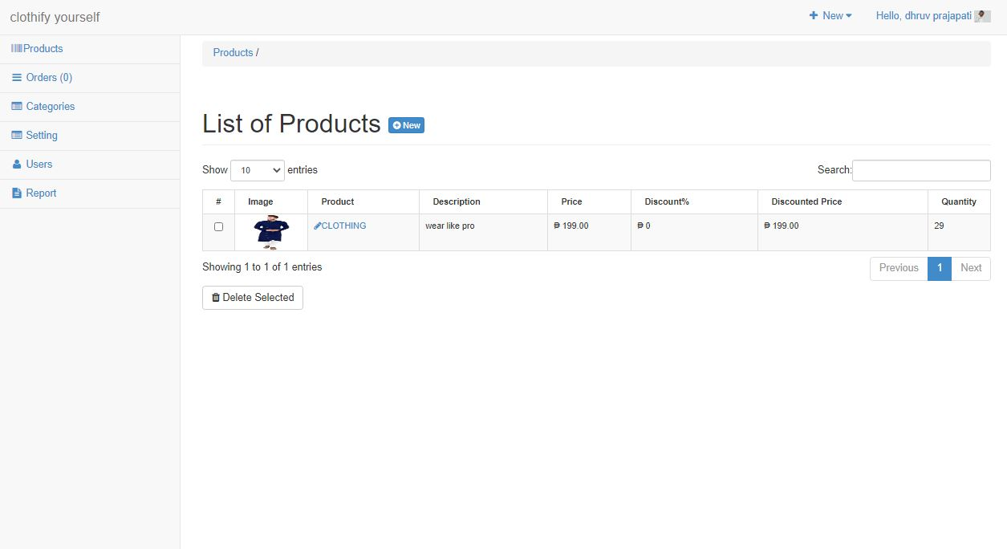
2.Admin dashboard

Slide 45
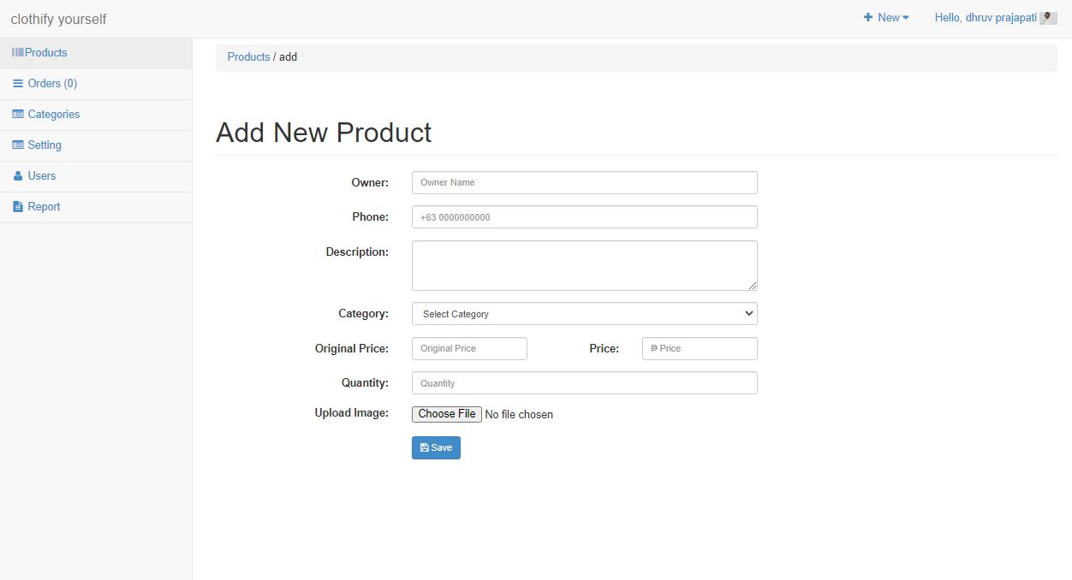
3.Product add

Slide 46
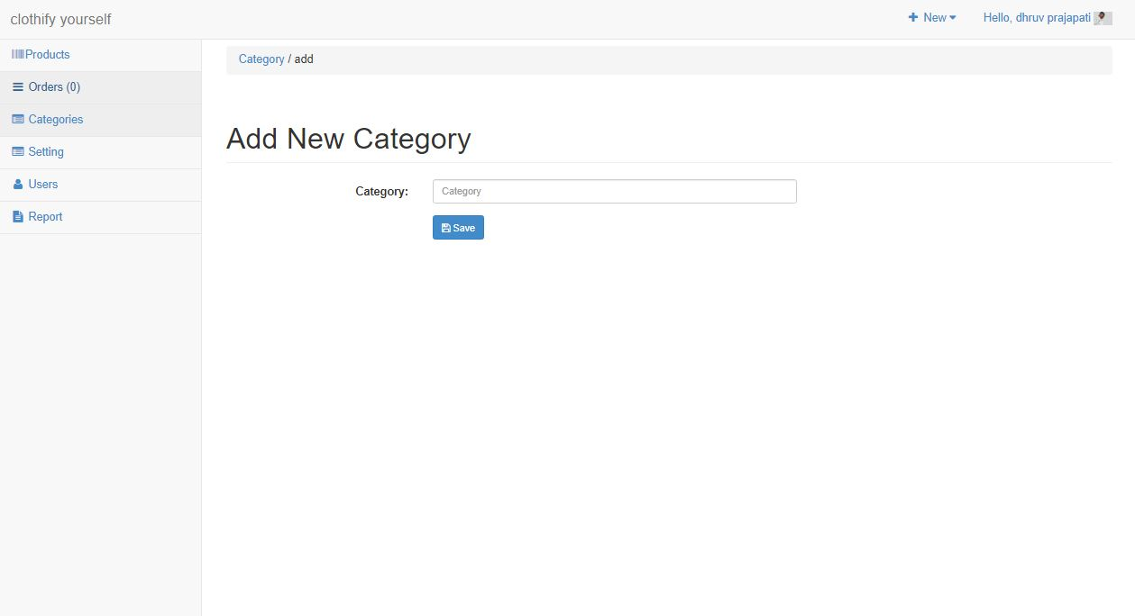
4.Add new category

Slide 47
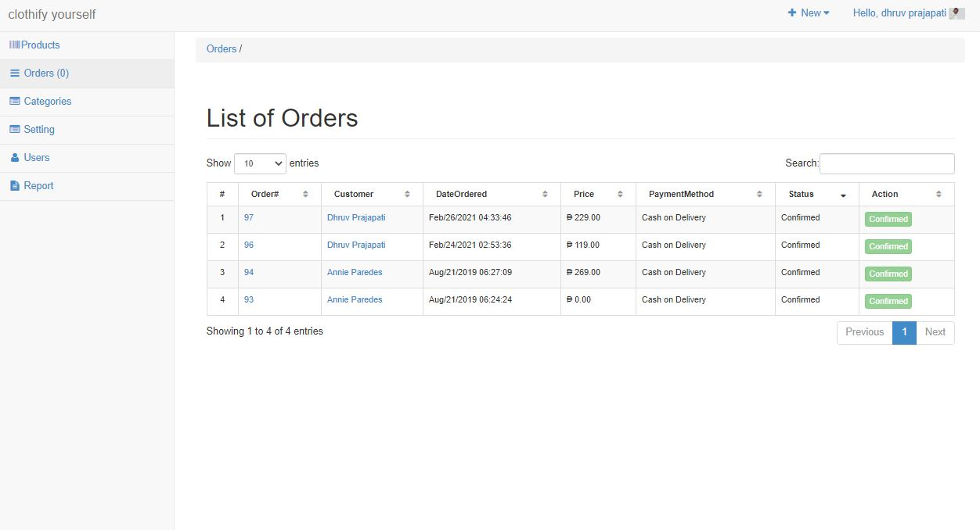
5.List of orders

Slide 48
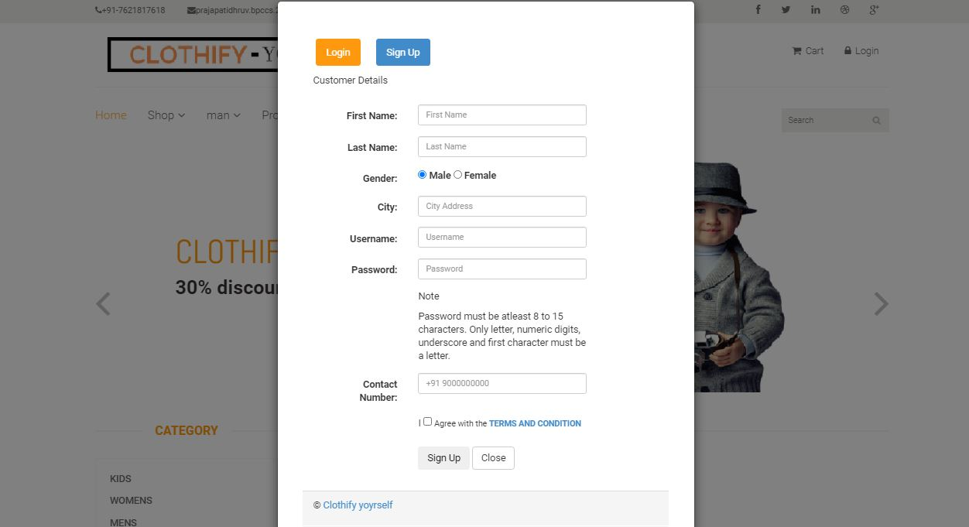
6.User registration

Slide 49
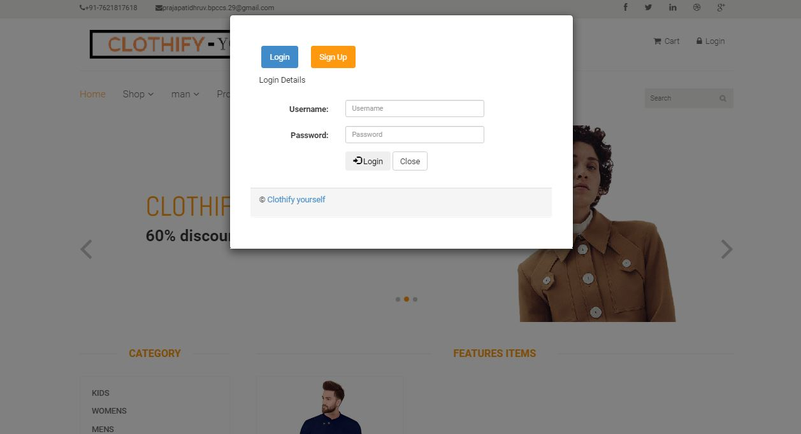
7.User login

Slide 50
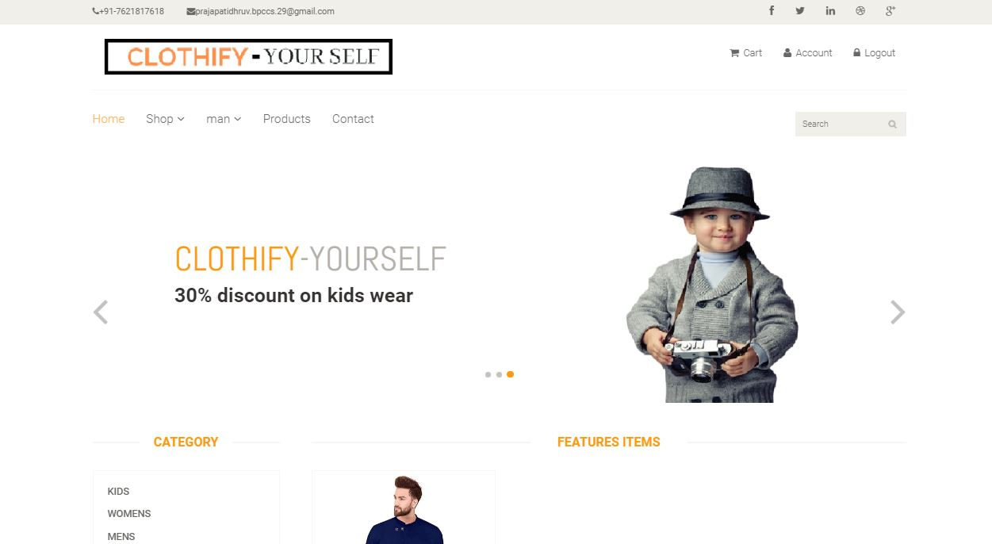
8.User panel

Slide 51
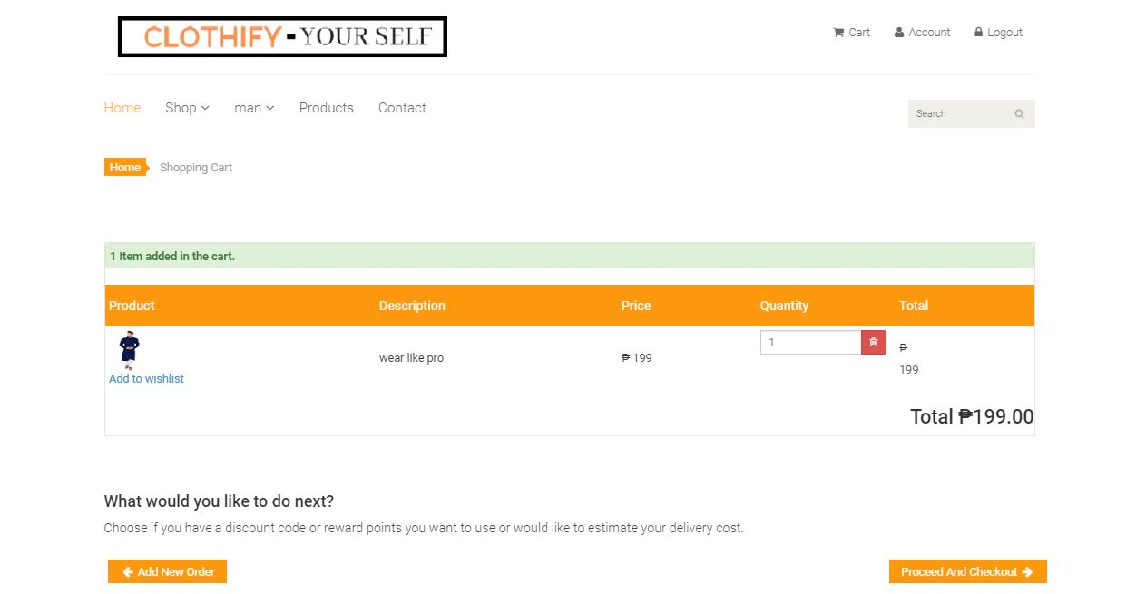
9.User cart

Slide 52
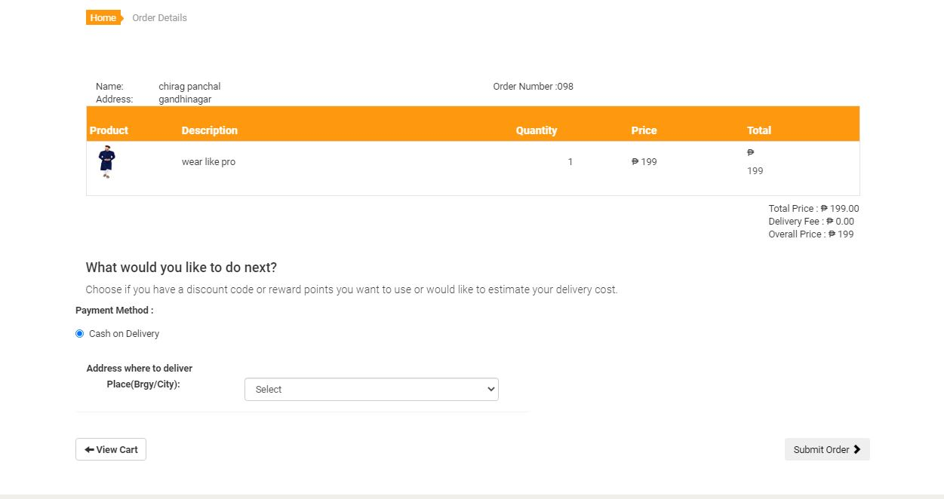
10.User order

Slide 53
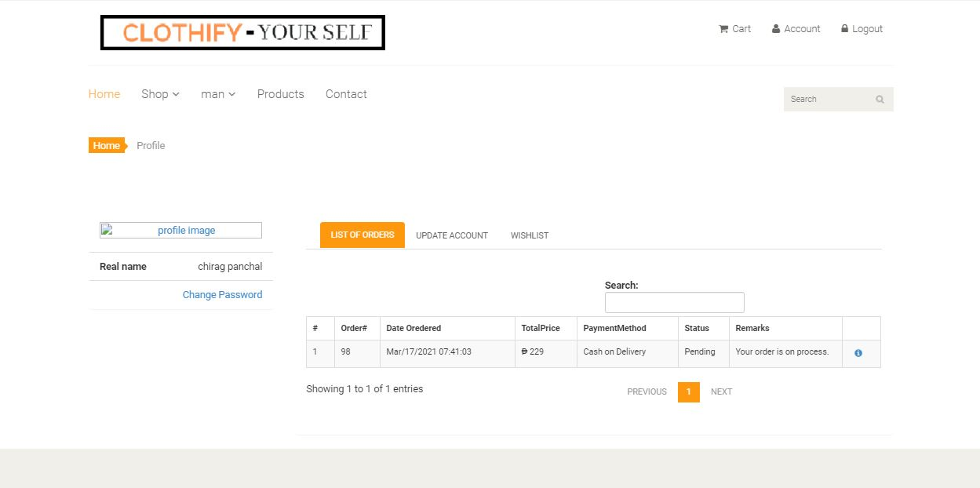
11.User account

Slide 54
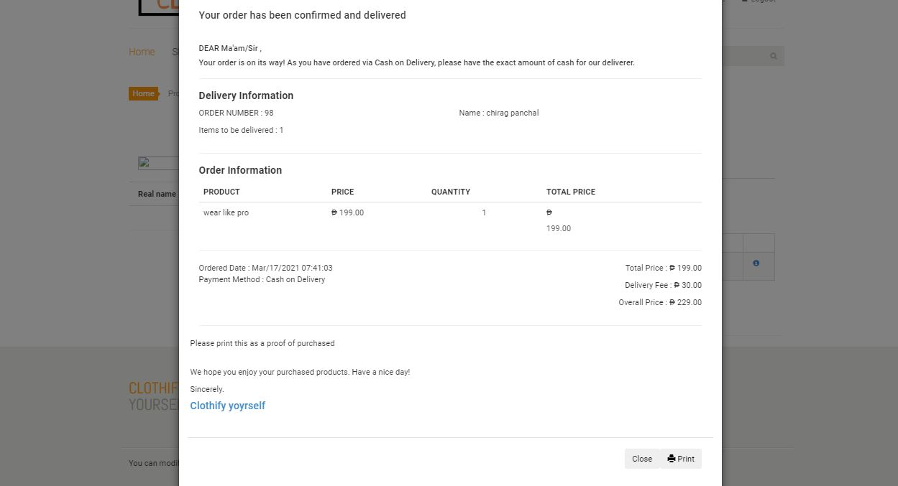
12.Order invoice

